Slide 1
September 2019
A New Generation of Global Logistisc
Where we are headed

Slide 2
About us
In harmony with the society
Excalibur guarantees security, comfort, and satisfaction by working with local companies to foster mutual development. In accordance with our corporate philosophy, we strive to become a corporate group where the employees think about what they can do for our clients and how to convert the client’s ideas into actions.

Slide 3
13K
6 mln
Deliveries
Turnover
1586
A
Rating
Happy Clients
Invariably high quality
Nowadays, it is more important than ever to be absolutely sure that your business partners will be there tomorrow, both in the short and long term perspective. Excalibur is a member of the Estonian Chamber of Commerce and Industry, has credit rating A and ISO 9001, ISO 14001, OHSAS 18001 certificates.

Slide 4
56%
13%
We operate on three continents
Russia
Asia
24%
7%
North America
Europe

Slide 5
We strive to ensure a perfect service for our clients by delivering stability, reliability, and transparency. Our wide network of Excalibur partners guarantees a stable chain of supply, consistent business style, and localised approach in any region.
Our Services
FTL Services
LTL Services
Customs Clearance
This service is perfect if the shipment is large enough to fill a full truckload. We also offer temperature-controlled vehicles with two drivers to reduce the delivery time.
The LTL service is ideal for transporting smaller shipments. Thanks to cargo consolidation at the warehouses and during delivery, you pay only for the truck space occupied by your cargo.
Our team of experienced certified and qualified customs filers can be of assistance in any customs clearance process.

Slide 6
We offer reliable and efficient personalised solutions, supported by a comprehensive online tracking and control system to achieve complete transparency and peace of mind.
Our Services
Warehouses
Contract Logistics
Customs Broker
Our warehousing solutions combine modern technologies, experience, and knowledge, optimising the efficiency of supply chains and reducing the waiting time.
Our reliable and balanced business approach ensures consistency and makes the reality meet the expectations.
Our team of experts will review your products, apply for the appropriate licenses, and agree on all fees.

Slide 7
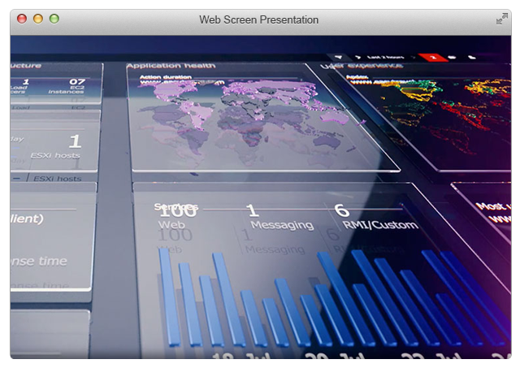
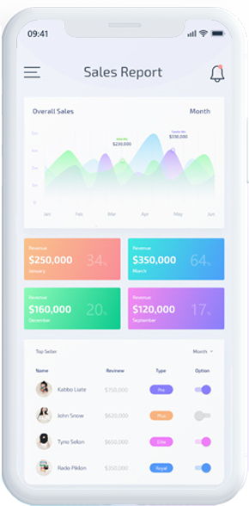
Software
Personal solutions
Operating our own software allows us to rapidly respond to customer needs and deliver highly customized transportation solutions. Our technology platform provides the benefits of a global footprint without losing sight of our customers’ individual requirements.

Slide 8
Vision
We strive to offer innovative products and services to our clients and the society. We hope to share the dreams and aspirations of people from all levels of society, grow together, and realise these dreams. We want to play a beneficial role in the society and make our transportation network more attractive and flourishing. We offer services which affect all aspects of people’s daily lives with the aim of creating a richer future for all of us.

Slide 9
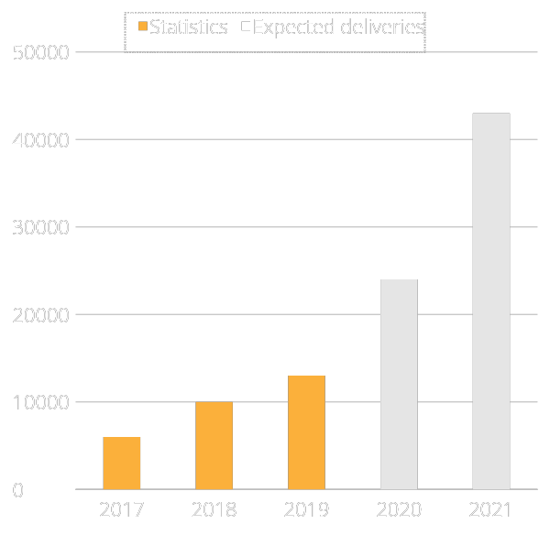
The secret to our growth
In year
Excalibur always works hard to adhere to the core values on which the organisation is built. Our philosophy compels us to take care of our clients, our employees, and the environment in which we work through integrity, quality control, innovation, environmental sustainability, and corporate social responsibility to build trust and ensure stable growth of the company.

Slide 10
This is not the limit …
We do our best and push the limits to establish new and valuable connections between people, processes, and data in order to find new ways of ensuring growth for our clients.
Watch video.

Slide 11
Contact
+372 600 41 84
How to reach us
marketing@libur.ee
Our office
Lõõtsa 8A 11415 Tallinn, Estonia
www.libur.ee

